Slide 1
안드로이드 실무 7주차 과제
1901055 정시철

Slide 2
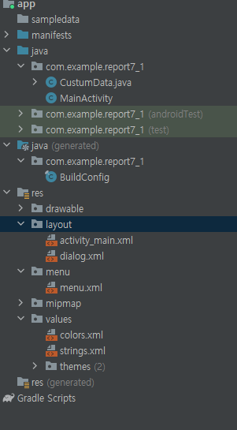
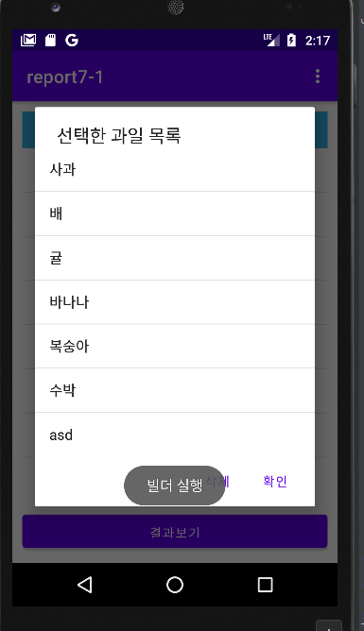
Report 1 과일 선택
package com.example.report7_1; import androidx.annotation.NonNull; import androidx.appcompat.app.AlertDialog; import androidx.appcompat.app.AppCompatActivity; import android.content.Context; import android.content.DialogInterface; import android.os.Bundle; import android.view.LayoutInflater; import android.view.Menu; import android.view.MenuInflater; import android.view.MenuItem; import android.view.View; import android.widget.AdapterView; import android.widget.ArrayAdapter; import android.widget.Button; import android.widget.EditText; import android.widget.ListView; import android.widget.TextView; import android.widget.Toast; import com.google.android.material.internal.CheckableImageButton; import java.util.ArrayList; import java.util.Collections; import java.util.List; public class MainActivity extends AppCompatActivity { EditText editText; ListView listView; ArrayAdapter<String> adapter; ArrayAdapter<String> adapter2; List<String> list = new ArrayList<>(); List<String> list2 = new ArrayList<>(); @Override protected void onCreate(Bundle savedInstanceState) { super.onCreate(savedInstanceState); setContentView(R.layout.activity_main); TextView textView = findViewById(android.R.id.empty); listView = findViewById(R.id.listView); Button button = findViewById(R.id.button); list.add(new CustomData("사과").text1Data); list.add(new CustomData("배").text1Data); list.add(new CustomData("귤").text1Data); list.add(new CustomData("바나나").text1Data); list.add(new CustomData("복숭아").text1Data); list.add(new CustomData("수박").text1Data); adapter = new ArrayAdapter<>(this,android.R.layout.simple_list_item_multiple_choice, list); adapter2 = new ArrayAdapter<>(this,android.R.layout.simple_list_item_1, list2); listView.setAdapter(adapter); listView.setOnItemClickListener(new AdapterView.OnItemClickListener() { @Override public void onItemClick(AdapterView<?> adapterView, View view, int i, long l) { String data = (String) adapterView.getItemAtPosition(i); Toast.makeText(MainActivity.this,data,Toast.LENGTH_SHORT).show(); }}); button.setOnClickListener(new View.OnClickListener() { @Override public void onClick(View view) { Toast.makeText(MainActivity.this, "빌더 실행", Toast.LENGTH_SHORT).show(); ListView listView2 = new ListView(MainActivity.this); listView2.setAdapter(adapter2); AlertDialog.Builder builder = new AlertDialog.Builder(MainActivity.this); builder.setTitle("선택한 과일 목록"); for (int i=0;i<adapter.getCount();i++){ if (listView.getCheckedItemPositions().get(i)){ list2.add(new CustomData(list.get(i)).text1Data); } } builder.setView(listView2); builder.setNegativeButton("삭제", new DialogInterface.OnClickListener() { @Override public void onClick(DialogInterface dialogInterface, int i) { int q = 0; for (int j=adapter.getCount()-1;j>=0;j--){ if (listView.getCheckedItemPositions().get(j)){ list.remove(j); q++; } } Toast.makeText(MainActivity.this, q+"개 항목 삭제됨", Toast.LENGTH_SHORT).show(); list2.clear(); listView.clearChoices(); adapter.notifyDataSetChanged(); adapter2.notifyDataSetChanged(); if (adapter.getCount()==0) listView.setEmptyView(textView); }}); builder.setPositiveButton("확인", new DialogInterface.OnClickListener() { @Override public void onClick(DialogInterface dialogInterface, int i) { adapter2.notifyDataSetChanged(); list2.clear(); } }); builder.show(); }}); } @Override public boolean onCreateOptionsMenu(Menu menu) { MenuInflater inflater = getMenuInflater(); inflater.inflate(R.menu.menu,menu); return true; } @Override public boolean onOptionsItemSelected(@NonNull MenuItem item) { int count; switch (item.getItemId()) { case R.id.m1: count = 0; count = adapter.getCount() ; for (int i=0; i<count; i++) { listView.setItemChecked(i, true); }break; case R.id.m2: count = 0; count = adapter.getCount() ; for (int i=0; i<count; i++) { listView.setItemChecked(i, false); }break; case R.id.m3: AlertDialog.Builder builder = new AlertDialog.Builder(this); builder.setTitle("과일 입력"); LayoutInflater inflater = getLayoutInflater(); View view = inflater.inflate(R.layout.dialog, null); builder.setView(view); builder.setPositiveButton("확인", new DialogInterface.OnClickListener() { @Override public void onClick(DialogInterface dialogInterface, int i) { editText = view.findViewById(R.id.editText1); String edit1 = String.valueOf(editText.getText()); list.add(edit1); adapter.notifyDataSetChanged(); }}); builder.show(); break; case R.id.m4: Toast.makeText(MainActivity.this, "애플리케이션이 종료되었습니다.", Toast.LENGTH_SHORT).show(); finish(); } return super.onOptionsItemSelected(item); } }
<?xml version="1.0" encoding="utf-8"?> <LinearLayout xmlns:android="http://schemas.android.com/apk/res/android" android:layout_width="match_parent" android:layout_height="match_parent" xmlns:tools="http://schemas.android.com/tools" android:orientation="vertical" android:padding="5pt" android:background="#33B5E5" tools:context=".MainActivity"> <TextView android:layout_width="wrap_content" android:layout_height="wrap_content" android:textSize="10pt" android:text="과일 입력 :"/> <EditText android:layout_width="120pt" android:layout_height="wrap_content" android:textSize="10pt" android:hint="과일을 입력해주세요." android:id="@+id/editText1"/> </LinearLayout>
package com.example.report7_1; import android.widget.EditText; class CustomData { String text1Data; EditText text2Data; public CustomData(String s) { this.text1Data = s; } public CustomData(EditText e){ this.text2Data = e; } }
<?xml version="1.0" encoding="utf-8"?> <menu xmlns:android="http://schemas.android.com/apk/res/android" android:layout_width="match_parent" android:layout_height="match_parent"> <item android:title="전체선택" android:id="@+id/m1"/> <item android:title="선택해제" android:id="@+id/m2"/> <item android:title="데이터 입력" android:id="@+id/m3"/> <item android:title="종료" android:id="@+id/m4"/> </menu>
<?xml version="1.0" encoding="utf-8"?> <LinearLayout xmlns:android="http://schemas.android.com/apk/res/android" xmlns:app="http://schemas.android.com/apk/res-auto" xmlns:tools="http://schemas.android.com/tools" android:layout_width="match_parent" android:layout_height="match_parent" android:orientation="vertical" android:padding="5pt" tools:context=".MainActivity"> <LinearLayout android:padding="5pt" android:layout_width="match_parent" android:layout_height="wrap_content" android:gravity="center" android:background="#33B5E5"> <TextView android:layout_width="wrap_content" android:layout_height="wrap_content" android:text="아래 목록에서 좋아하는 과일을 선택하세요."/> </LinearLayout> <ListView android:id="@+id/listView" android:choiceMode="multipleChoice" android:layout_width="match_parent" android:layout_height="180pt"> </ListView> <TextView android:id="@android:id/empty" android:layout_width="match_parent" android:layout_height="match_parent" android:padding="10dp" android:text="비었습니다" android:gravity="center" android:textColor="#ff0000" android:visibility="gone"/> <Button android:id="@+id/button" android:layout_width="match_parent" android:layout_height="wrap_content" android:gravity="center" android:padding="5pt" android:text="결과보기" /> </LinearLayout>

Slide 3
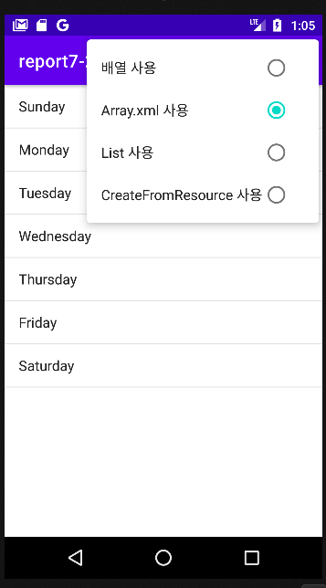
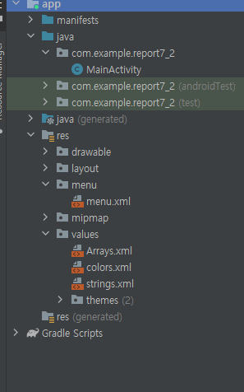
Report 2 리스트뷰 예제
<?xml version="1.0" encoding="utf-8"?> <menu xmlns:android="http://schemas.android.com/apk/res/android" android:layout_width="match_parent" android:layout_height="match_parent"> <group android:checkableBehavior="single"> <item android:id="@+id/m1" android:checked="true" android:title="배열 사용" /> <item android:id="@+id/m2" android:title="Array.xml 사용" /> <item android:id="@+id/m3" android:title="List 사용" /> <item android:id="@+id/m4" android:title="CreateFromResource 사용"/> </group> </menu>
<?xml version="1.0" encoding="utf-8"?> <resources> <string-array name="data"> <item >Sunday</item> <item >Monday</item> <item >Tuesday</item> <item >Wednesday</item> <item >Thursday</item> <item >Friday</item> <item >Saturday</item> </string-array> <string-array name="data2"> <item>日曜日</item> <item>月曜日</item> <item>火曜日</item> <item>水曜日</item> <item>木曜日</item> <item>金曜日</item> <item>土曜日</item> </string-array> </resources>
package com.example.report7_2; import androidx.annotation.NonNull; import androidx.appcompat.app.AppCompatActivity; import android.annotation.SuppressLint; import android.os.Bundle; import android.view.Menu; import android.view.MenuInflater; import android.view.MenuItem; import android.widget.ArrayAdapter; import android.widget.ListView; import android.widget.RadioButton; import java.lang.reflect.Array; import java.util.ArrayList; import java.util.List; public class MainActivity extends AppCompatActivity { ArrayAdapter adapter; ListView listView; @Override protected void onCreate(Bundle savedInstanceState) { super.onCreate(savedInstanceState); setContentView(R.layout.activity_main); listView = (ListView)findViewById(R.id.listView); String[] type1 = {"일요일(SUN)","월요일(NON)", "화요일(TUE)","수요일(WED)", "목요일(THU)","금요일(FRI)", "토요일(SAT)"}; adapter = new ArrayAdapter<String>(this,android.R.layout.simple_list_item_1,type1); listView.setAdapter(adapter); } @Override public boolean onCreateOptionsMenu(Menu menu) { MenuInflater inflater = getMenuInflater(); inflater.inflate(R.menu.menu,menu); return true; } @Override public boolean onOptionsItemSelected(@NonNull MenuItem item) { listView = (ListView)findViewById(R.id.listView); switch (item.getItemId()) { case R.id.m1: item.setChecked(!item.isChecked()); String[] type1 = {"일요일(SUN)","월요일(NON)", "화요일(TUE)","수요일(WED)", "목요일(THU)","금요일(FRI)", "토요일(SAT)"}; adapter = new ArrayAdapter<String>(this,android.R.layout.simple_list_item_1,type1); listView.setAdapter(adapter); break; case R.id.m2: item.setChecked(!item.isChecked()); String[] type2 = getResources().getStringArray(R.array.data); adapter = new ArrayAdapter<String>(this,android.R.layout.simple_list_item_1,type2); listView.setAdapter(adapter); break; case R.id.m3: item.setChecked(!item.isChecked()); List<String> list = new ArrayList<>(); list.add("일요일"); list.add("월요일"); list.add("화요일"); list.add("수요일"); list.add("목요일"); list.add("금요일"); list.add("토요일"); adapter = new ArrayAdapter<>(this,android.R.layout.simple_list_item_1, list); listView.setAdapter(adapter); break; case R.id.m4: item.setChecked(!item.isChecked()); adapter = ArrayAdapter.createFromResource(getApplicationContext(), R.array.data2, android.R.layout.simple_list_item_1); listView.setAdapter(adapter); } return super.onOptionsItemSelected(item); } }
메뉴의 라디오버튼이 움직이지 않아서 case에서 그냥 직접 코드로 움직이게 했습니다.
<?xml version="1.0" encoding="utf-8"?> <LinearLayout xmlns:android="http://schemas.android.com/apk/res/android" xmlns:app="http://schemas.android.com/apk/res-auto" xmlns:tools="http://schemas.android.com/tools" android:layout_width="match_parent" android:layout_height="match_parent" tools:context=".MainActivity"> <ListView android:layout_width="match_parent" android:layout_height="match_parent" android:id="@+id/listView" /> </LinearLayout>

Slide 4
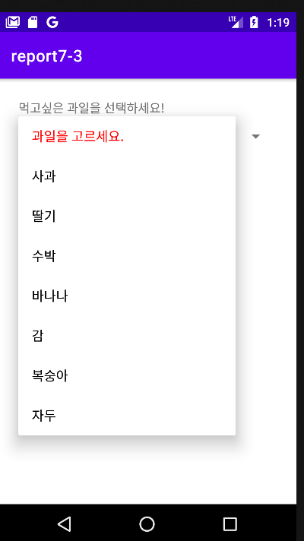
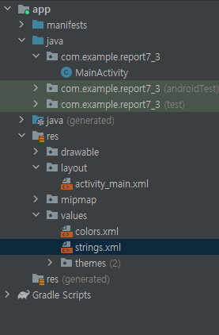
Report 3
<resources> <string name="app_name">report7-3</string> <string-array name="fruits"> <item>과일을 선택하세요.</item> <item>사과</item> <item>딸기</item> <item>수박</item> <item>바나나</item> <item>감</item> <item>복숭아</item> <item>자두</item> </string-array> </resources>
<?xml version="1.0" encoding="utf-8"?> <LinearLayout xmlns:android="http://schemas.android.com/apk/res/android" xmlns:tools="http://schemas.android.com/tools" android:layout_width="match_parent" android:layout_height="match_parent" android:orientation="vertical" android:padding="25dp" tools:context=".MainActivity"> <TextView android:layout_width="match_parent" android:layout_height="wrap_content" android:text="먹고싶은 과일을 선택하세요." android:textSize="8pt"/> <Spinner android:id="@+id/spinner" android:layout_width="match_parent" android:layout_height="wrap_content" /> </LinearLayout>
package com.example.report7_3; import androidx.appcompat.app.AppCompatActivity; import android.graphics.Color; import android.os.Bundle; import android.view.View; import android.view.ViewGroup; import android.widget.AdapterView; import android.widget.ArrayAdapter; import android.widget.Spinner; import android.widget.TextView; import android.widget.Toast; import java.util.ArrayList; import java.util.Arrays; import java.util.List; public class MainActivity extends AppCompatActivity { @Override protected void onCreate(Bundle savedInstanceState) { super.onCreate(savedInstanceState); setContentView(R.layout.activity_main); final Spinner spinner = (Spinner) findViewById(R.id.spinner); String[] fruits = new String[]{ "과일을 골라주세요.", "사과", "딸기", "수박", "바나나", "감", "복숭아", "자두", }; final List<String> list = new ArrayList<>(Arrays.asList(fruits)); final ArrayAdapter<String> spinnerArrayAdapter = new ArrayAdapter<String>(this, android.R.layout.simple_list_item_1 ,list){ @Override public boolean isEnabled(int position){ if(position == 0) { return false; } else { return true; } } @Override public View getDropDownView(int position, View convertView, ViewGroup parent) { View view = super.getDropDownView(position, convertView, parent); TextView textView = (TextView) view; if(position == 0){ textView.setTextColor(Color.RED); } else { textView.setTextColor(Color.BLACK); }return view; }}; spinnerArrayAdapter.setDropDownViewResource(android.R.layout.simple_list_item_1); spinner.setAdapter(spinnerArrayAdapter); spinner.setOnItemSelectedListener(new AdapterView.OnItemSelectedListener() { @Override public void onItemSelected(AdapterView<?> parent, View view, int position, long id) { String selectedfruit = (String) parent.getItemAtPosition(position); if(position > 0){ Toast.makeText(getApplicationContext(), selectedfruit +"는 맛있다.", Toast.LENGTH_SHORT).show(); } } @Override public void onNothingSelected(AdapterView<?> parent) { }}); } }

